Slide 1

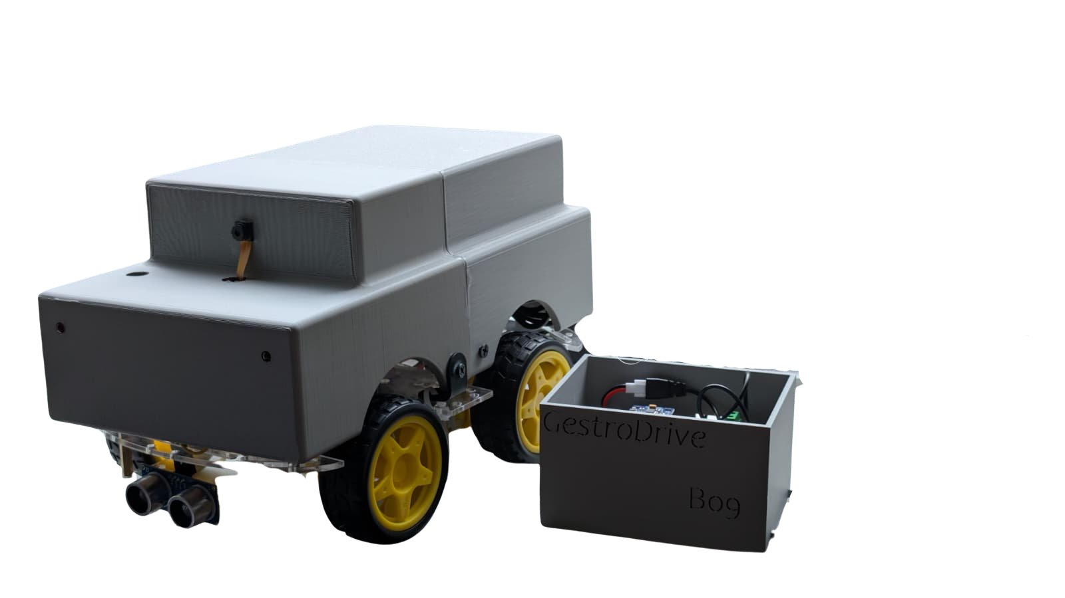


GestroDrive Robotics Innovations
Hand Gesture Controlled Robotic Car Presentation
Exploring the future of gesture-based technology in robotic applications and automation
Prepared by:
Arth Raval
Vansh Dve

Slide 2


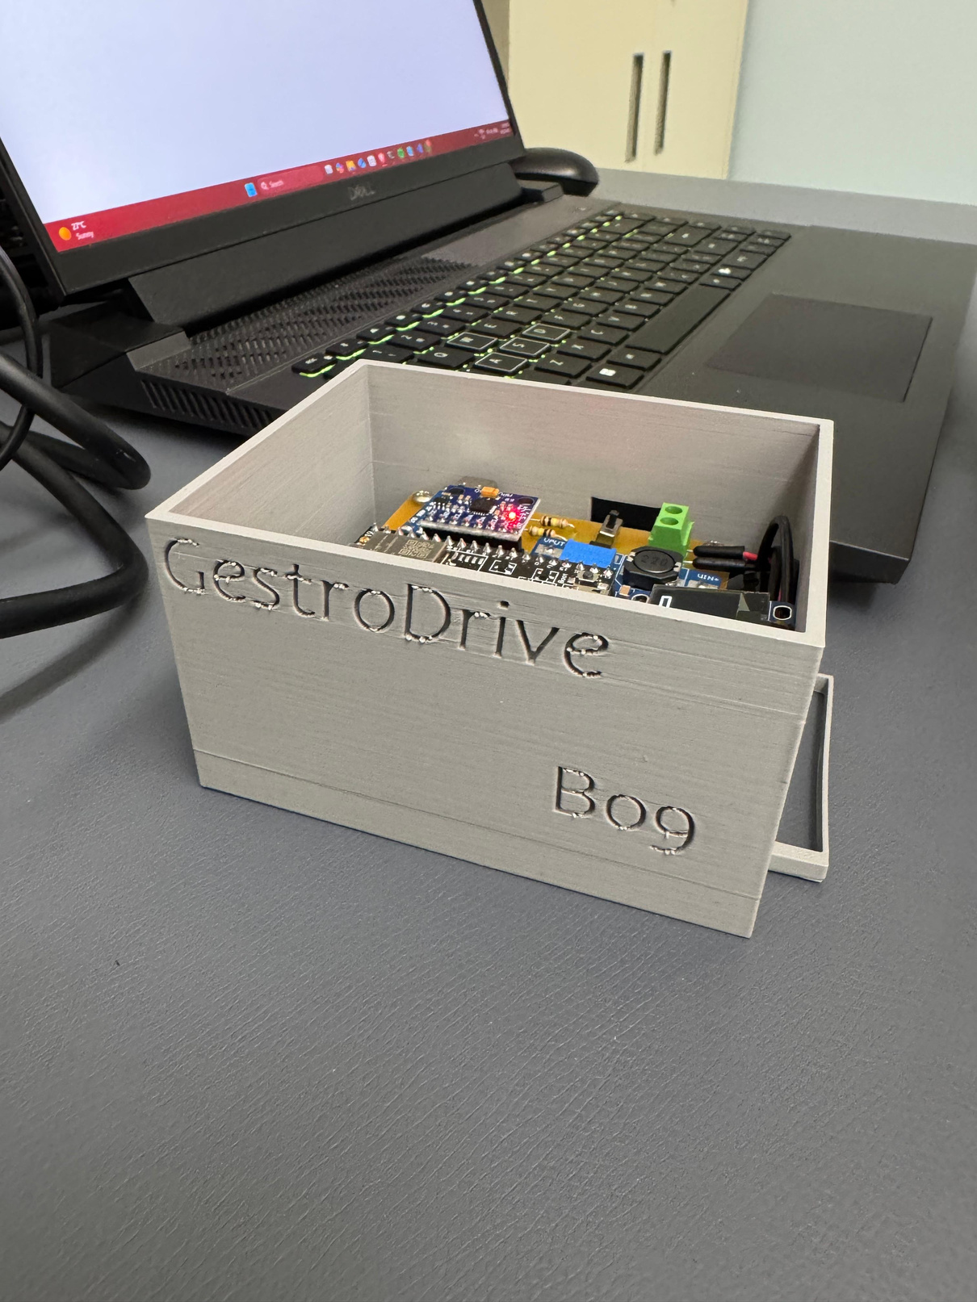
Project Overview
Exploring GestroDrive: Hand Gesture Controlled Robotic Car and Its Innovative Capabilities
The project aims to create a revolutionary robotic car using hand gestures for control.
By integrating advanced sensors and machine learning techniques, this project enhances user interaction and aims to transform transportation by making it more intuitive and accessible for everyone.
2

Slide 3
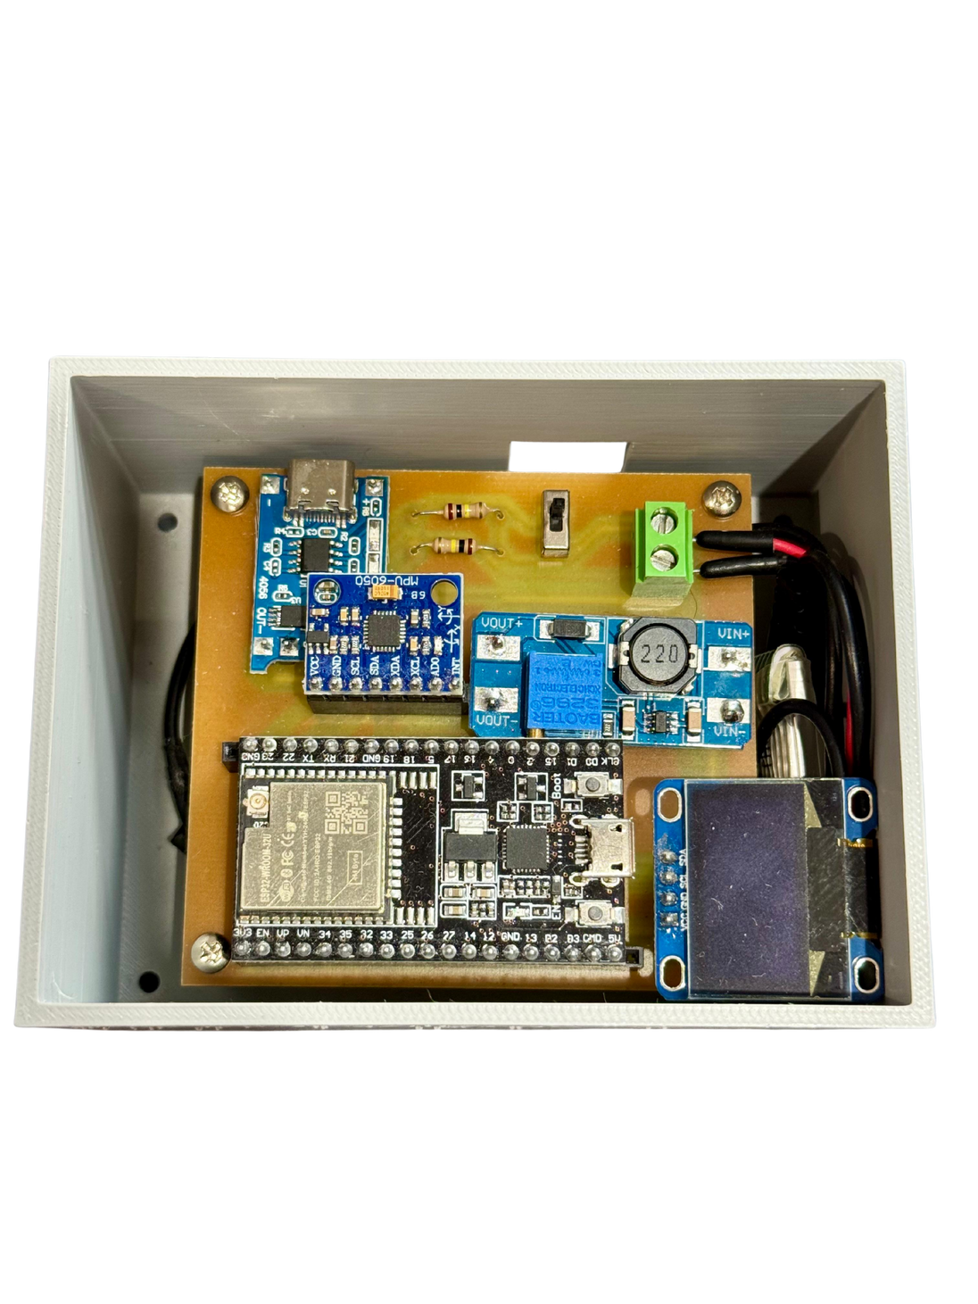
Motivation for Gesture Control
This section outlines the key motivators driving the development of our gesture-controlled robotic car project.
Enhancing accessibility for users with mobility challenges through gesture control technology.
Improving user experience by allowing intuitive and seamless interactions with robotic devices.
Developing innovative solutions to integrate technology into everyday activities and environments.
Promoting engagement and interaction in robotics through interactive control methods.
Addressing the demand for hands-free technology in modern robotic applications and systems.
3

Slide 4
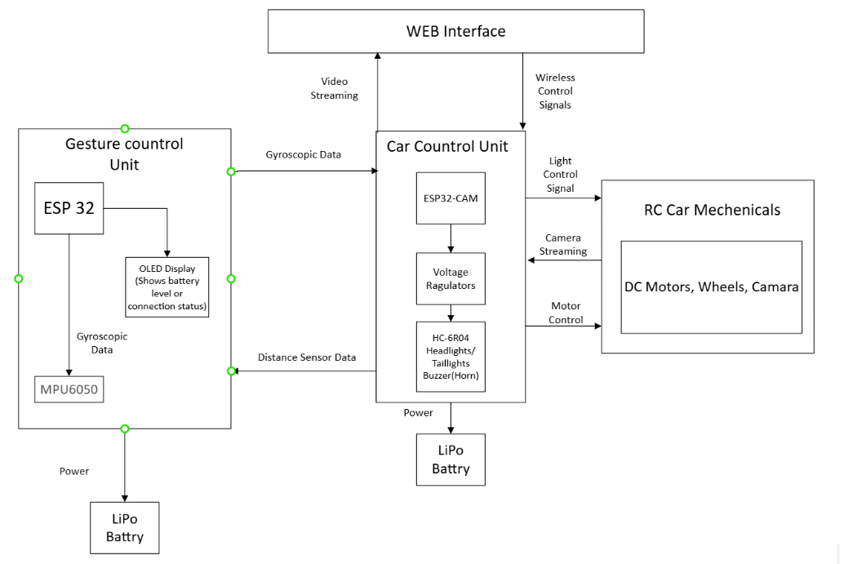
System Overview
Visual Representation of the System Architecture for GestroDrive Robotic Car Project
The system block diagram illustrates how each component interacts within the GestroDrive project.
It showcases the integration of hand gesture controls, processing units, and the robotic car's functionality, highlighting the innovative approach of this technology.
4

Slide 5
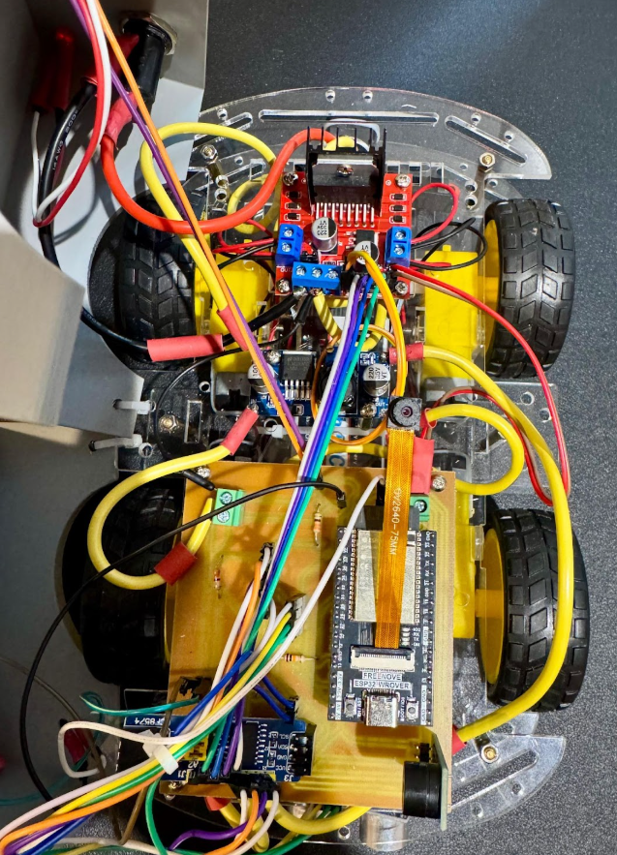
Hardware Overview: Gesture Unit & Car Unit
An in-depth look at the essential hardware components of GestroDrive's robotic car system
The Gesture Unit detects hand movements, allowing intuitive control of the car unit. This seamless integration enhances user experience, demonstrating the potential of gesture-controlled robotics in everyday applications.
5

Slide 6

Key Features of GestroDrive
Intuitive Control for seamless operation
Enhanced Safety protocols during usage
Real-Time Feedback for user engagement
Users can operate the car effortlessly through natural hand gestures without any complex controls.
The system incorporates safety measures to prevent accidents and ensure user protection at all times.
Immediate feedback is provided to users, enhancing the overall experience and ensuring precise control over the robotic car.
6

Slide 7
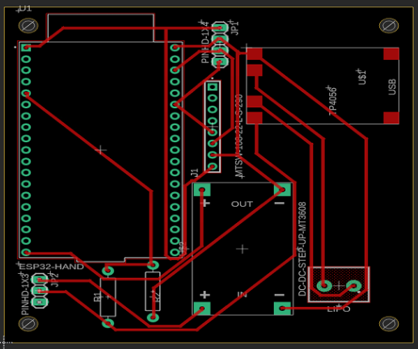
Detailed PCB Analysis
Exploring the intricate design and functionality of the printed circuit board for GestroDrive technology
The printed circuit board (PCB) is crucial for the operation of the robotic car.
It integrates all electronic components and ensures reliable communication between the gesture control unit and the car, enabling seamless interaction and control for users.
7

Slide 8
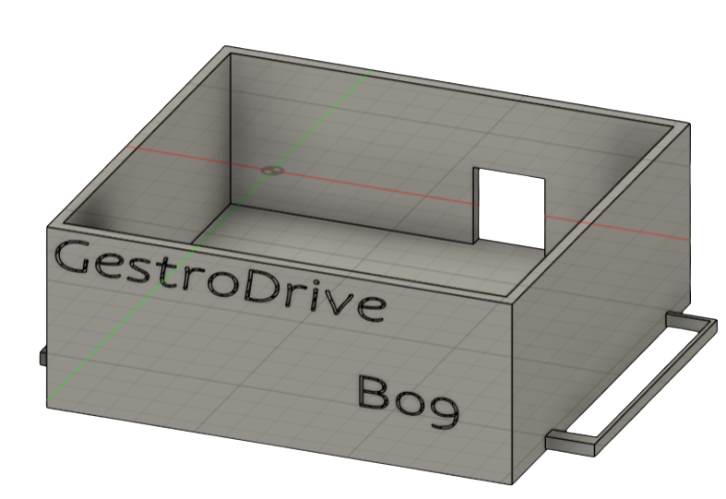
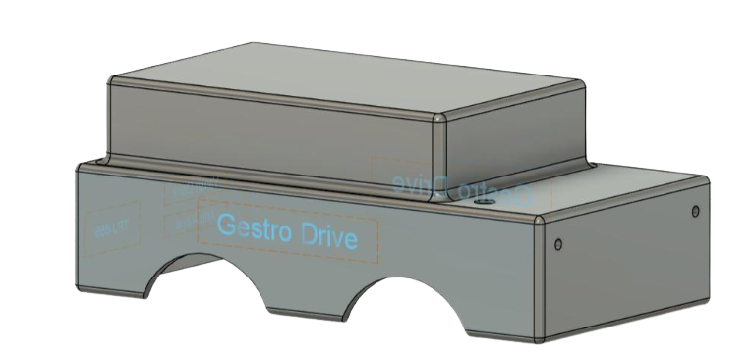
Mechanical Design Insights
An In-Depth Look at the 3D Models and Assembly of Our Gesture-Controlled Robotic Car
The mechanical design of the robotic car integrates advanced functionality and aesthetic appeal.
Our design emphasizes precision engineering to ensure each component works harmoniously, enhancing the overall performance and reliability of the car while maintaining an attractive visual profile.
8

Slide 9
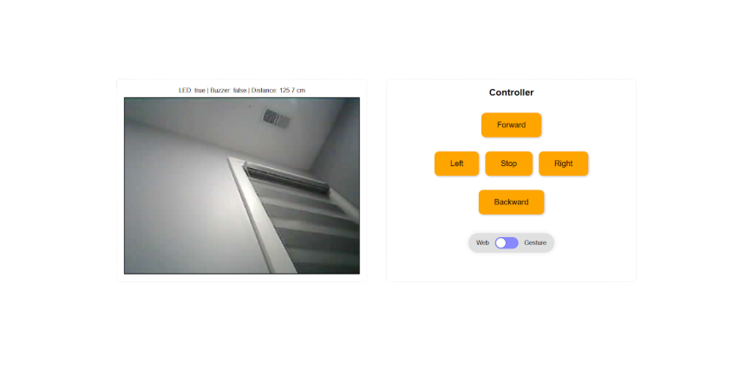
IoT Component Overview
Exploring the Integration and User Interface of the IoT Component for GestroDrive
The IoT dashboard provides a user-friendly interface for monitoring and controlling the robotic car.
It displays real-time data and allows users to interact with the system seamlessly, enhancing the overall experience of using the GestroDrive technology.
9

Slide 10

Theory of Operation Overview
In this section, we will explore the technology behind the GestroDrive system and its functionalities.
Gesture recognition technology and its implementation in the robotic car.
Communication between the gesture unit and the robotic car system.
Real-time processing of hand gestures and control commands.
Integration with IoT for enhanced user interaction.
Testing and validation of the system performance.
10

Slide 11

Bill of Materials for GestroDrive
Index | Name | Description | Link | Price (CAD)
1 | Gesture ESP32 | ESP32 DevKitC ESP32-WROOM-32U | https://a.co/d/19M24zs | 16.99
2 | Car ESP32 | Freenove ESP32-WROVER CAM Board | https://a.co/d/5iR4utZ | 24.95
3 | Gyroscope | Wishiot 3pcs GY-521 MPU-6050 | https://a.co/d/fq2lYtE | 15.99
4 | Motor Driver | L298N Motor DC Dual H-Bridge Motor Driver | https://a.co/d/aazGgPM | 19.99
5 | Other Components | Chassis, LDR, OLED, LiPo batteries, Resistors, Wires etc. | N/A | 322.52
 |  |  | Total | 375.49
11

Slide 12
Challenges and Solutions Overview
This section addresses the key hurdles faced during development and the solutions implemented to overcome them.
Identifying technical limitations in gesture recognition systems
Improving communication between hardware components for efficiency
Overcoming power management issues in the robotic car
Addressing user interface challenges for the IoT dashboard
Ensuring durability and reliability in mechanical design components
12

Slide 13
Maintenance of GestroDrive Systems
This section outlines essential upkeep to ensure optimal performance and longevity of the robotic car.
Regular inspection of hardware components for wear and tear
Importance of software updates for functionality and security improvements
Cleaning and maintenance of sensors for accurate gesture recognition
Battery management and charging practices for extended use
Troubleshooting common issues for seamless operation and reliability
13

Slide 14
Future Enhancements for GestroDrive
Here are potential improvements and expansions to consider for the ongoing development of GestroDrive.
Enhanced gesture recognition for improved user experience and accuracy.
Integration of AI for smarter decision-making and adaptability in various environments.
Expansion of the hardware components to support more complex functionalities and features.
Development of a mobile application for remote control and monitoring of the car.
Exploration of sustainable energy sources to power the robotic car effectively.
14

Slide 15
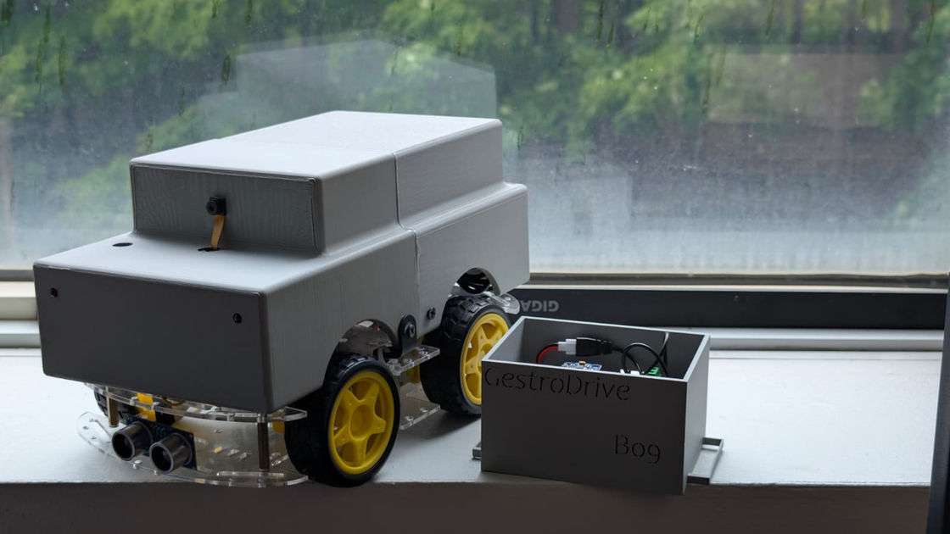
Conclusion of the GestroDrive Project
A significant advancement in gesture-controlled technology for robotics and automation.
The GestroDrive project demonstrates the potential of hand gesture technology in enhancing user interaction with robotic systems, paving the way for innovative applications in automation and intelligent devices.
15

Slide 16

Thank You for Your Attention
Email
rarth73@gmail.com
vdave18@gmail.com
Social Media
Arth - linkedin.com/in/arthraval
Vansh - linkedin.com/in/vansh-dave-ba2b02250
16

